Slide 1

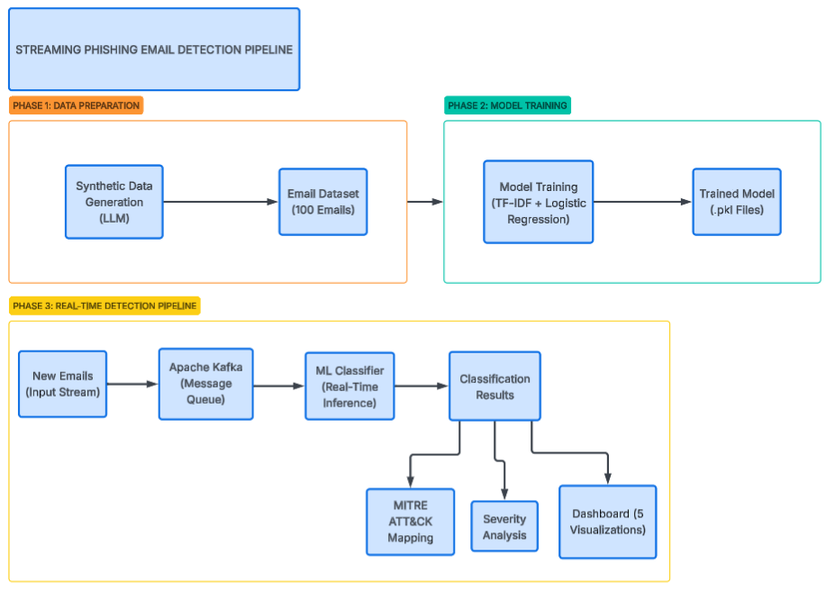
Dr. Andrei kozukhov & Viacheslav nefedov
Streaming Phishing Email Detection Pipeline Yarden levy & Nadav Shapira סמסטר א' תשפ"ו Fall semester 3rd year
AI-Driven Cybersecurity
Introduction
Phishing attacks are among the most prevalent cybersecurity threats,
responsible for over 90% of data breaches worldwide. Attackers impersonate
legitimate entities via email to steal sensitive information.
Project Objectives:
- Build a real-time processing pipeline for phishing detection
- Develop a machine learning model for email classification
- Map detected threats to the MITRE ATT&CK framework
- Create a visualization dashboard for analysis
Technology Stack:
- Apache Kafka 3.7.0 - Message streaming
- Python 3.11 with scikit-learn
- Jaeger - Distributed tracing
- Docker Compose - Containerization
Architecture & Methodology
The system implements an Event-Driven Architecture:
Data Flow Pipeline:
Synthetic Data (LLM) → Email Dataset → Apache Kafka → ML Classifier →
Results → MITRE ATT&CK Mapping → Dashboard
Machine Learning Model:
- Vectorization: TF-IDF (1,000 features, unigrams + bigrams)
- Algorithm: Logistic Regression with balanced class weights
- Key Phishing Indicators: urgency words, credential requests, suspicious URLs
Results & Visualization
Results Summary:
- Model Accuracy: 100%
- Total Emails Processed: 100
- Phishing Detected: 37 (37%)
- Legitimate Emails: 63 (63%)
MITRE ATT&CK Techniques Detected:
- T1598.003 - Phishing for Information: 18 detections
- T1566 - Generic Phishing: 16 detections
- T1566.002 - Spearphishing Link: 3 detections
Threat Severity Distribution:
- None (Legitimate): 63 emails
- Medium (Generic Phishing): 16 emails
- High (Spearphishing): 3 emails
- Critical (Credential Harvesting): 18 emails
Conclusions
Achieved Goals:
✓ Successfully built event-driven architecture with Apache Kafka
✓ Achieved 100% classification accuracy on test dataset
✓ Integrated MITRE ATT&CK framework for threat mapping
✓ Created comprehensive visualization dashboard
Comparison to Initial Targets:
- Target: Build real-time pipeline → Achieved ✓
- Target: ML model with >90% accuracy → Achieved 100% ✓
- Target: MITRE ATT&CK integration → Achieved ✓
- Target: Visualization dashboard → Achieved (5 charts) ✓
Discussion & Future Work
Key Achievements:
✓ Demonstrated feasibility of ML-based phishing detection
✓ Real-time processing with sub-second latency
✓ Comprehensive threat classification system
Future Development:
- NVIDIA Morpheus integration for GPU-accelerated inference
- Deep Learning models (BERT, Transformers)
- Real-time alerting and SIEM integration
- Expansion to malware and BEC attack detection

